Slide 1
Open Targets: integrating genetics, omics and chemical data for drug discovery
Winter Corporate School
EMBL Predocs, Heidelberg
Sep 11th 2019
Denise Carvalho-Silva, PhD
EMBL-EBI | Open Targets
Wellcome Genome Campus
United Kingdom

Slide 2
Workshop exercises
https://docs.targetvalidation.org/outreach/
latest-training-materials

Slide 3
This session 14:00-17:00
Introduction to Open Targets
Open Targets Platform: presentation + live demo
Coffee break → 15:15-15:30
Hands-on time
Feedback survey, wrap up, further discussion

Slide 4
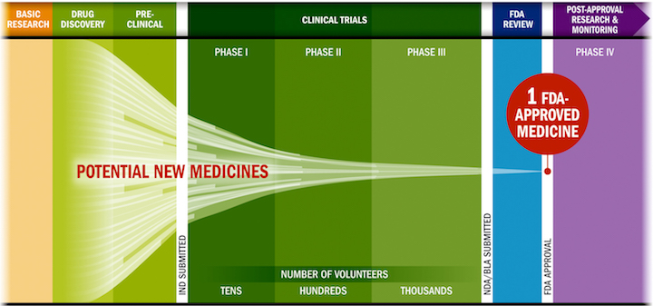
Drug discovery: some challenges
Lengthy, costly, low success rate, HIGH ATTRITION RATES
Source: PhRMA adaptation based on Tufts CSDD & School of Medicine, and FDA

Slide 5
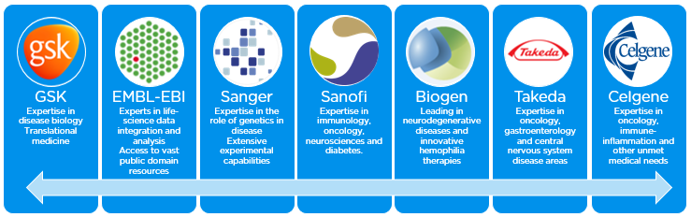
Open Targets
A partnership to transform drug discovery
Founded in 2014
Founding partners
2018
2016
2017
2018
Systematic identification and prioritisation of targets

Slide 6
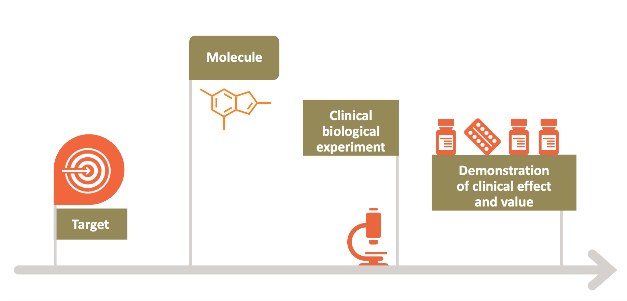
Selecting the right target
Drugs that fail are neither safe nor efficacious

Slide 7









Knowledge cycle
Public data
Experimental projects
Bioinformatics projects
DATA
GENERATION
DATA
INTEGRATION
Therapeutic hypothesis

Slide 8

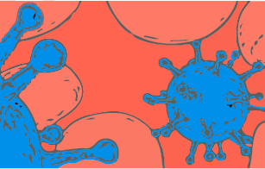
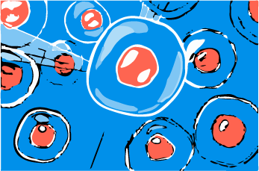
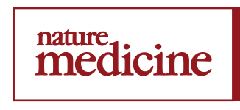

Data generation: therapeutic areas
2 complete projects
3 complete projects
3 manuscripts on bioRxiv
9 ongoing projects
7 ongoing projects
5 ongoing projects
1 publication (2019)
1 publication (2019)

Slide 9
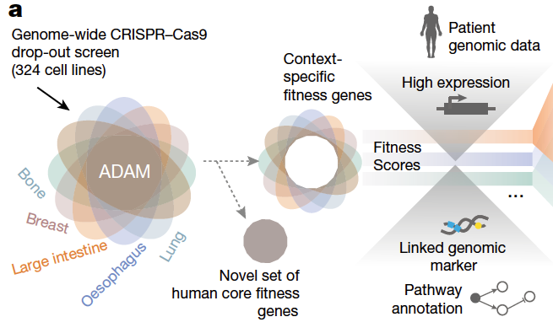
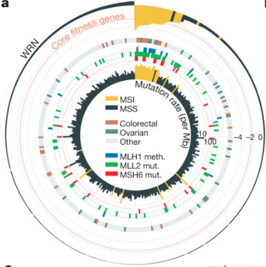
Behan et al (2019)
WRN sustains in vivo growth in:
colorectal
ovarian
endometrial
gastric
New candidate target for tumours with MSI (WRN antagonists)

Slide 10
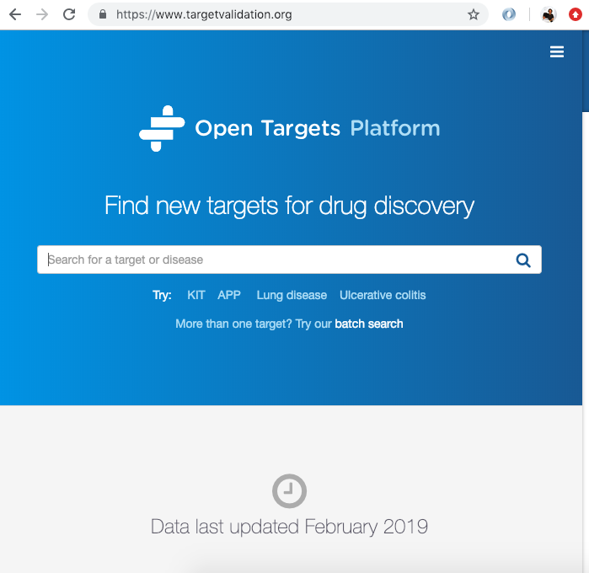
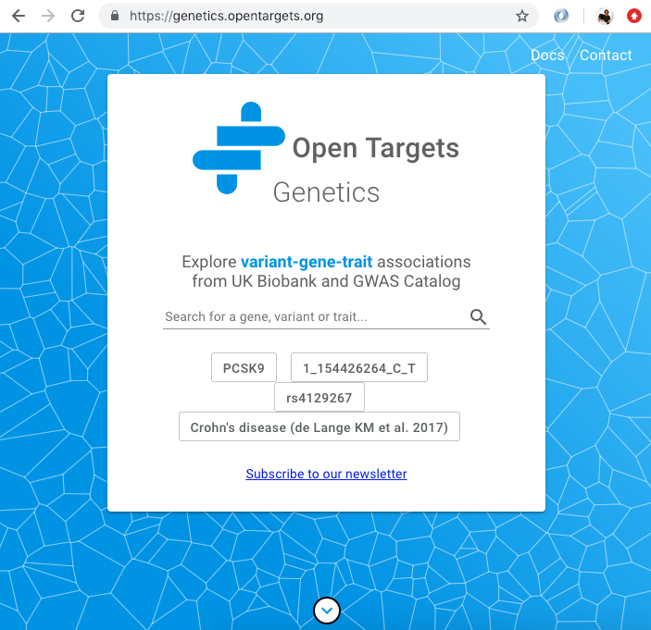
Data integration: web resources
Data integration: Open Targets
https://www.opentargets.org/resources/#open-targets-platform

Slide 11
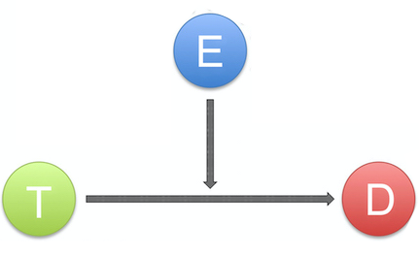
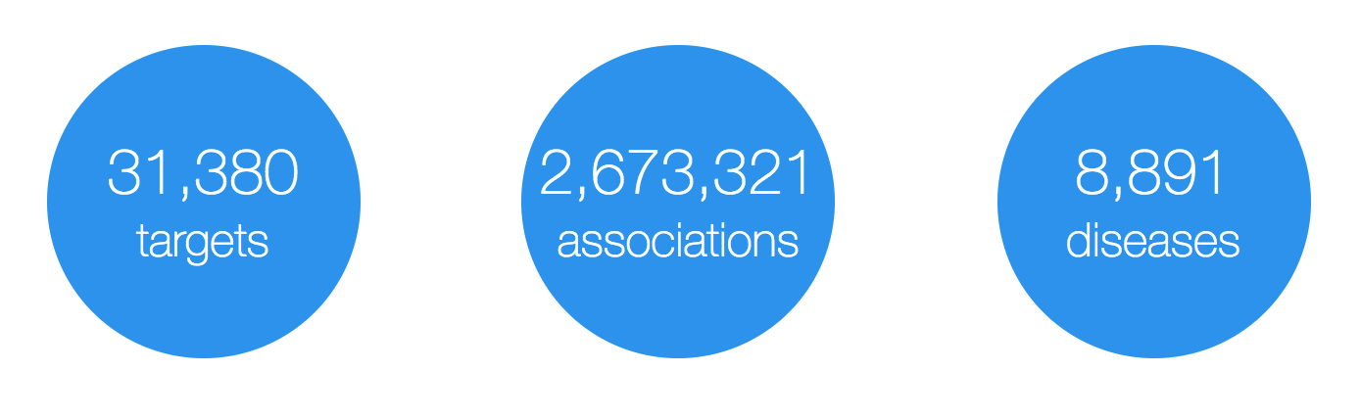
Open Targets Platform: data model
Evidence
(variants, drugs, literature, etc)
Target
(protein and non-protein coding genes)
Disease
(rare and common)
https://www.targetvalidation.org

Slide 12
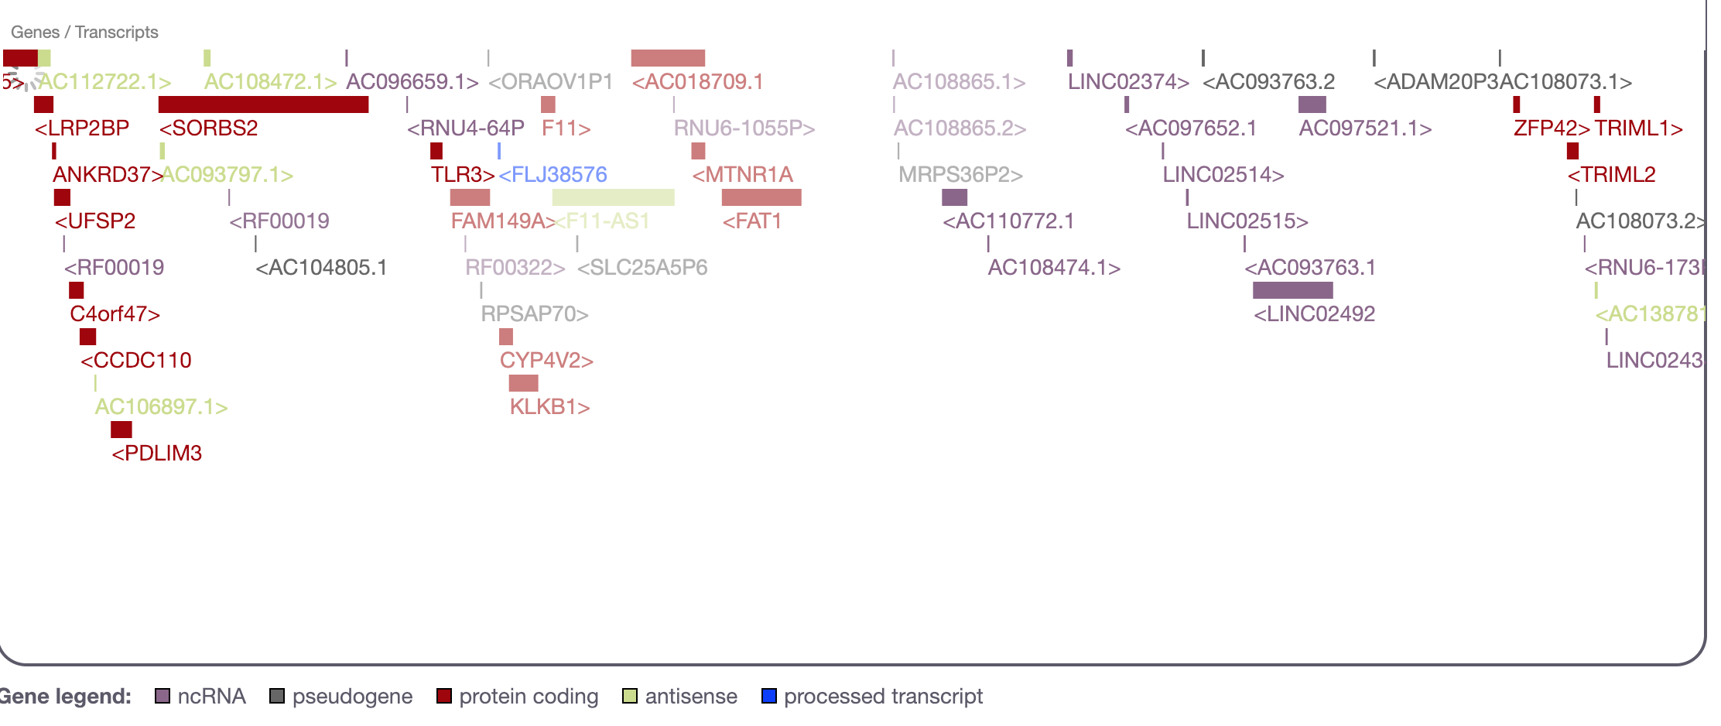
What is a target?
27K
targets
Examples
https://www.targetvalidation.org/target/ENSG00000255248
https://www.targetvalidation.org/target/ENSG00000175482?view=sec:genome_browser

Slide 13
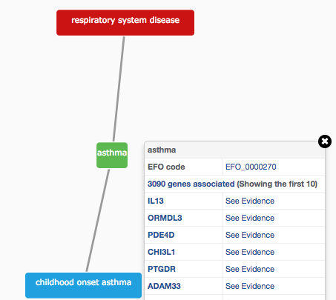
How do we describe our diseases?
Modified version of Experimental Factor Ontology (EFO)
Controlled vocabulary (Coeliac versus Celiac)
Hierarchy (relationships)
Promotes consistency
Increases the richness of annotation
Allow for easier and automatic integration
10K
diseases

Slide 14
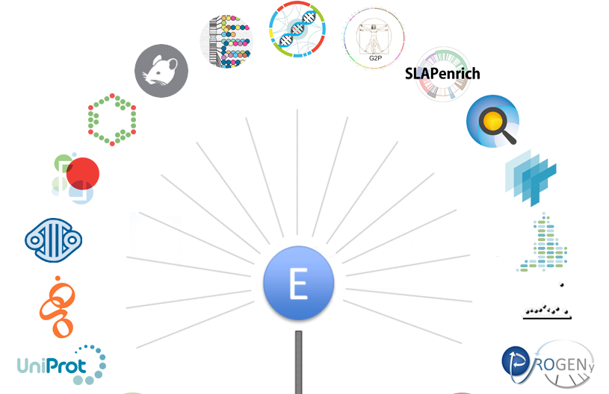
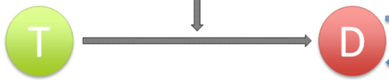
Evidence for our T-D associations
https://docs.targetvalidation.org/data-sources/data-sources

Slide 15
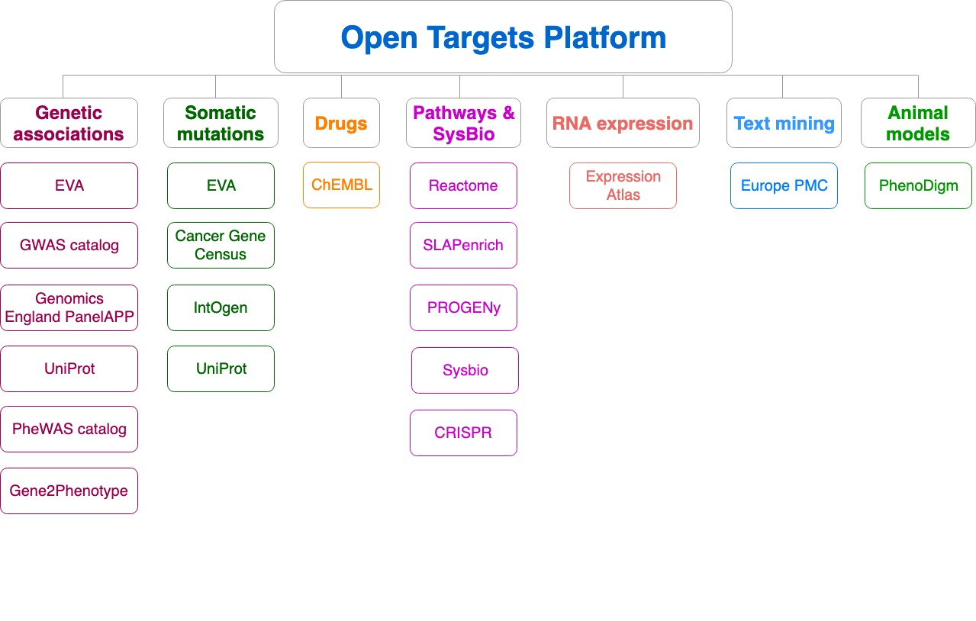
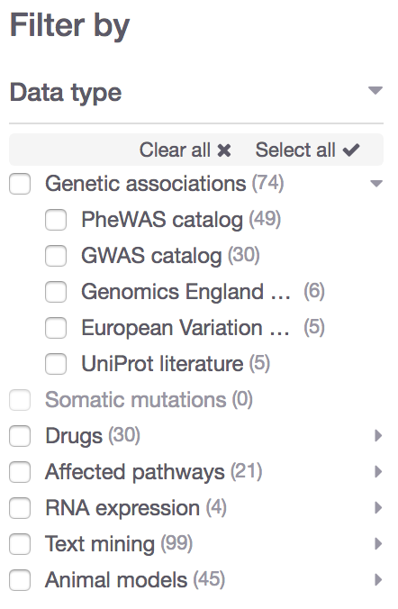
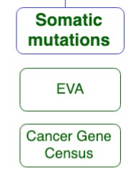
Data sources grouped into data types
Data type
Data source

Slide 16

What can you do with the Open Targets Platform?
Target-disease associations (+ evidence + score)
https://www.targetvalidation.org/evidence/ENSG00000141510/EFO_0000228
Target annotations
http://www.targetvalidation.org/target/ENSG00000141510
Disease annotations
http://www.targetvalidation.org/diseaset/EFO_0000228

Slide 17
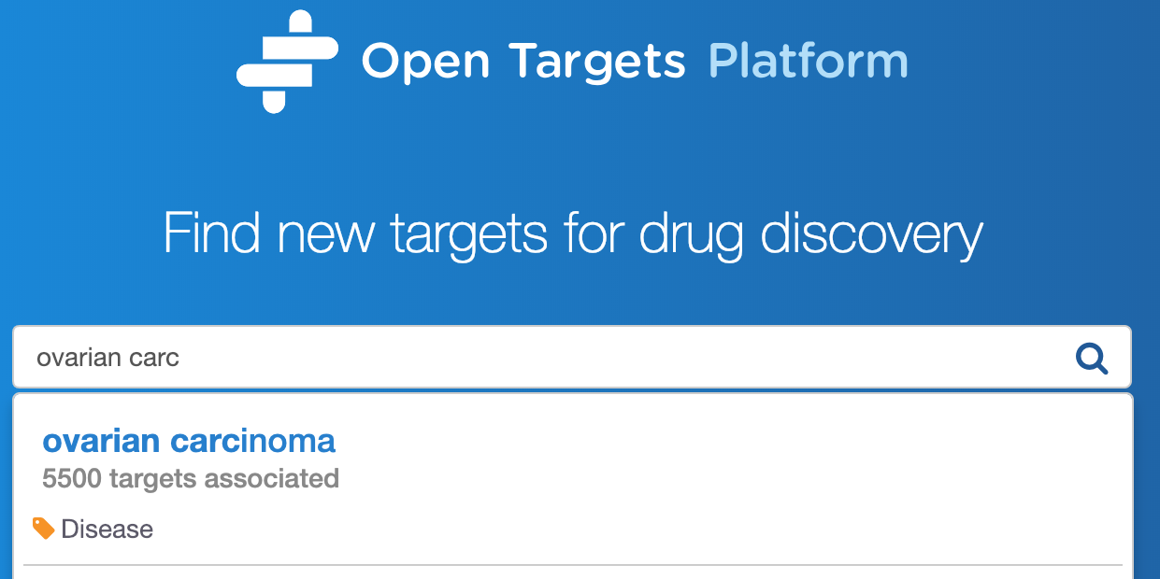
Demo 1
Which targets are associated with my disease?
What is the evidence for the association?
Is there any data to help to prioritise the list of associated targets?
Coursebook: pages 7-16

Slide 19
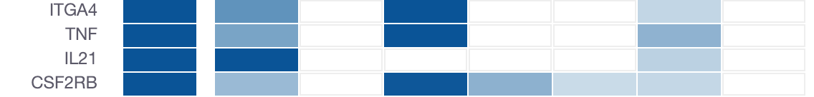
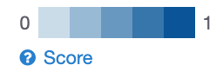
How well supported are the associations?
Association score to convey confidence
More evidence → stronger association score
Different evidence are scored and weighted in different ways
Overall score
Genetic
Somatic
Drugs
Pathways
Expression
Text mining
Animal mod

Slide 20
Evidence score to overall score
Statistical integration, aggregation and scoring
1) Evidence score (e.g. one SNP from a GWAS paper)
2) Data source score (e.g. all SNPs from the GWAS catalog)
3) Data type score (e.g. all sources of Genetic associations)
4) Overall association score
https://docs.targetvalidation.org/getting-started/scoring

Slide 21

Computing the score for one evidence
score = f * s * c
f, relative occurrence of a target-disease evidence
s, strength of the effect of the variant
c, confidence of the observation for the target-disease evidence
f = sample size (cases and controls)
s = predicted functional consequence (VEP)
c = p value reported in the paper
(Factors affecting the relative strength of GWAS Catalog evidence)

Slide 22
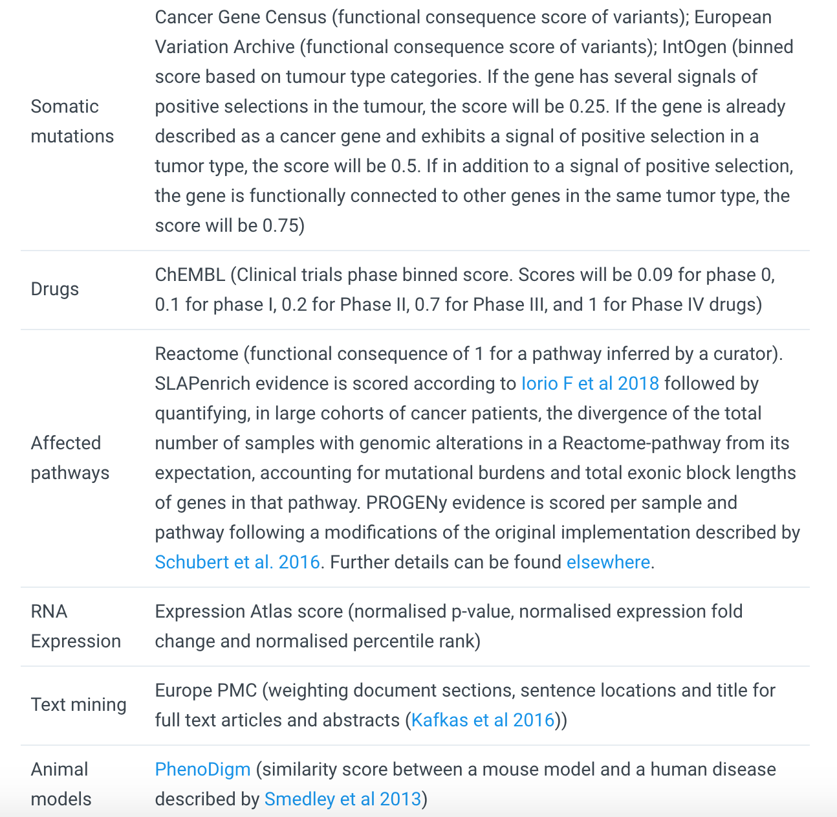
https://docs.targetvalidation.org/getting-started/scoring
Factors affecting the relative strength of the evidence

Slide 23
Harmonic sum
Σ_{H}
*1.0
Genomics England
Score: 0 to 1 (max)
Σ_{H}
*1.0
PheWAS catalog
Σ_{H}
*1.0
European Variation Archive (germline)
Σ_{H}
*1.0
Σ_{H}
Genetic associations
Calculated at four levels:
Evidence
Data source
Data type
Overall
UniProt
Σ_{H}
*1.0
Gene2Phenotype
Σ_{H}
*1.0
GWAS catalog
Σ_{H}
*1.0
Cancer Gene Census
Σ_{H}
*1.0
European Variation Archive (somatic)
Σ_{H}
Somatic mutations
Σ_{H}
*1.0
IntOGen
Aggregation with (harmonic sum)
Σ_{H}
Σ_{H}
*1.0
ChEMBL
Drugs
Σ_{H}
*1.0
Reactome
Note: Each data set has its own scoring and ranking scheme
Σ_{H}
*0.5
SLAPenrich
Σ_{H}
*0.5
Σ_{H}
Pathways &
systems biology
PROGENy
Σ_{H}
*0.5
Sysbio
Σ_{H}
*0.2
Expression Atlas
RNA expression
Σ_{H}
*0.2
Europe PMC
Text mining
Σ_{H}
*0.2
PhenoDigm
Animal models
weight factor
Σ_{H}
S₁ + S₂/2² + S₃/3² + S₄/4² + S_{i}/i²
Σ_{H}
Association

Slide 24
What can you do with the Open Targets Platform?
Target-disease associations (+ evidence + score)
https://www.targetvalidation.org/evidence/ENSG00000141510/EFO_0000228
Target annotations
https://www.targetvalidation.org/target/ENSG00000141510
Disease annotations
https://www.targetvalidation.org/diseaset/EFO_0000228

Slide 25
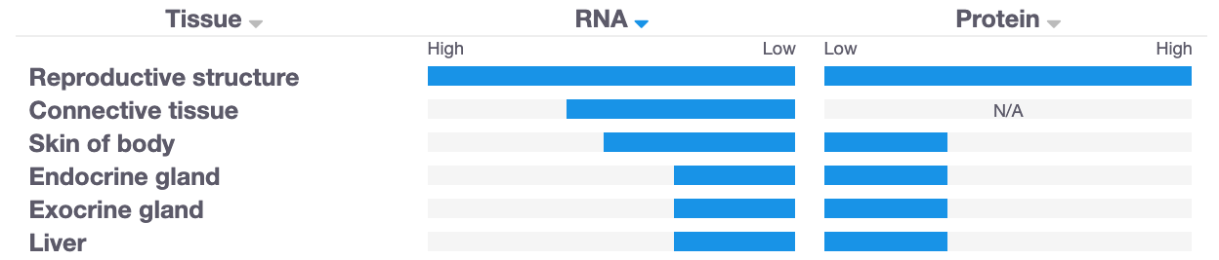
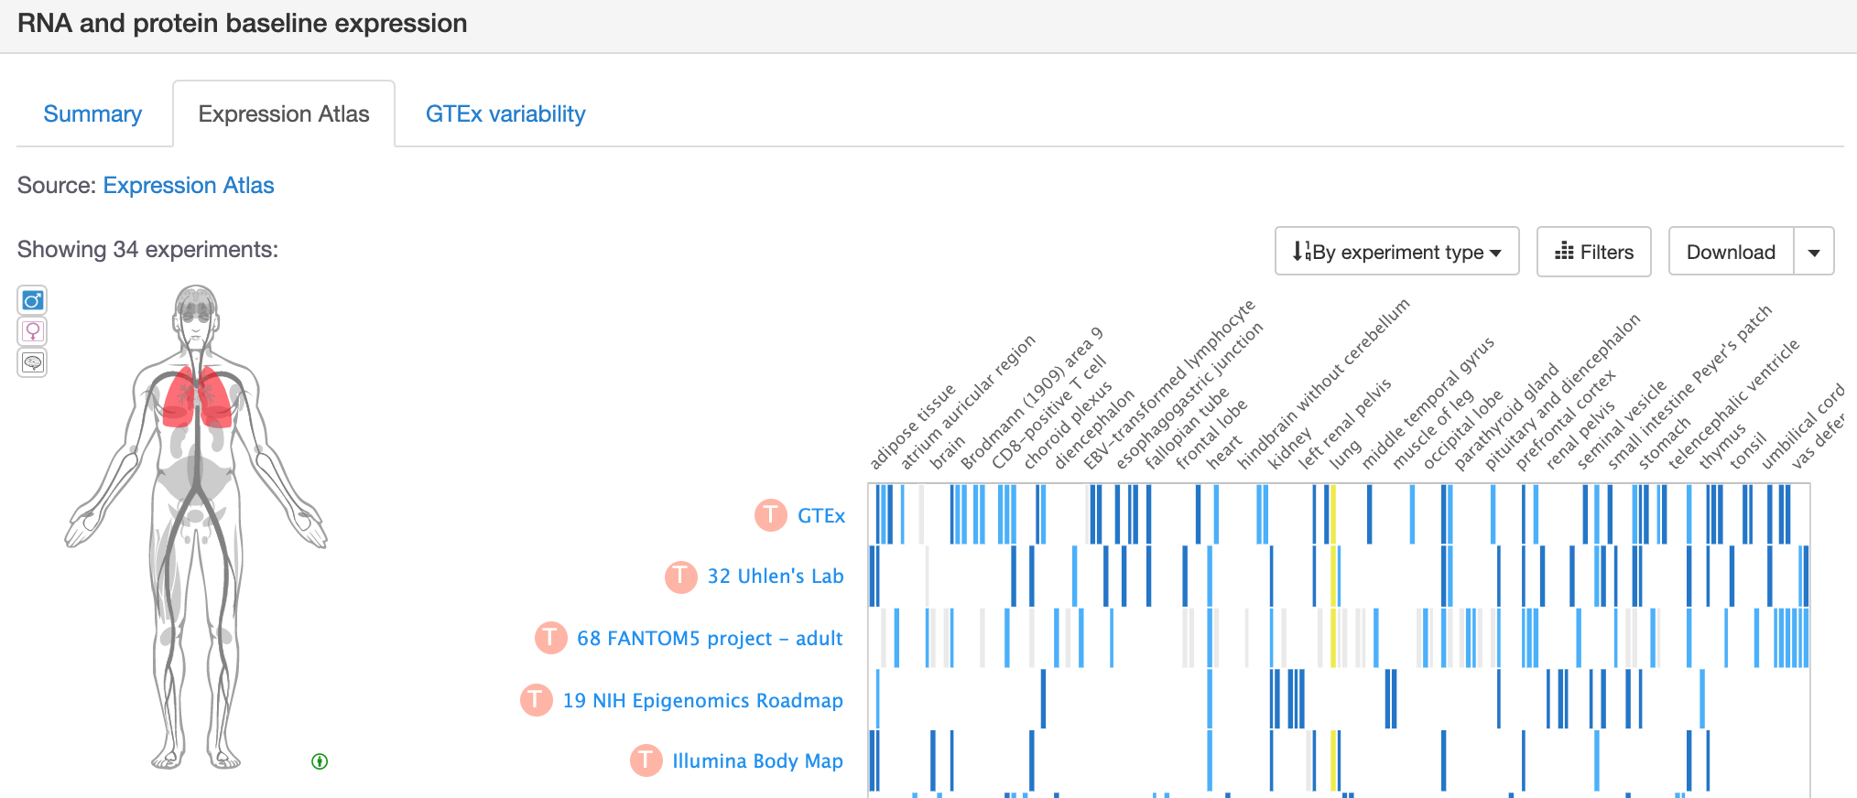
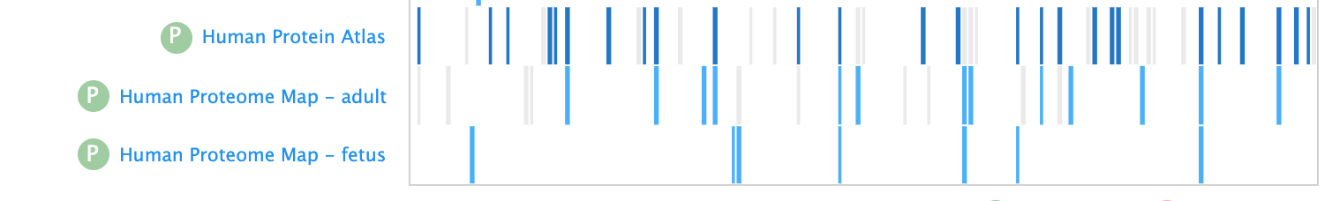
Is my target expressed in the relevant tissue?

Slide 26
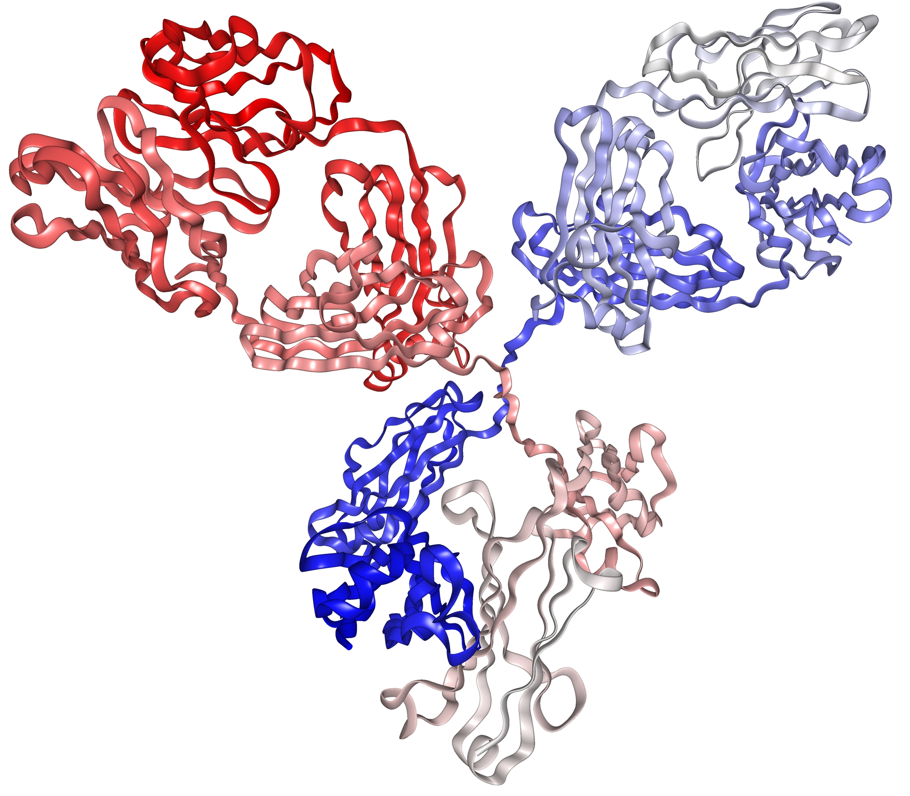
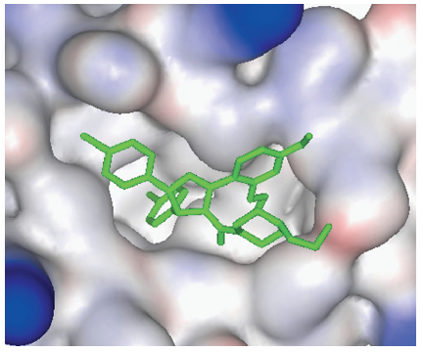
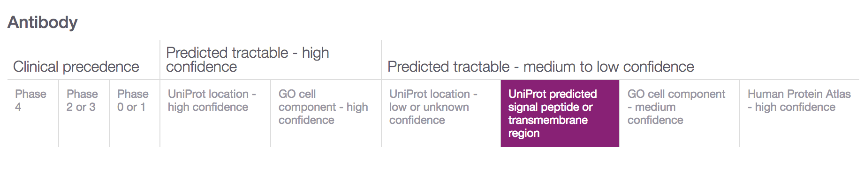
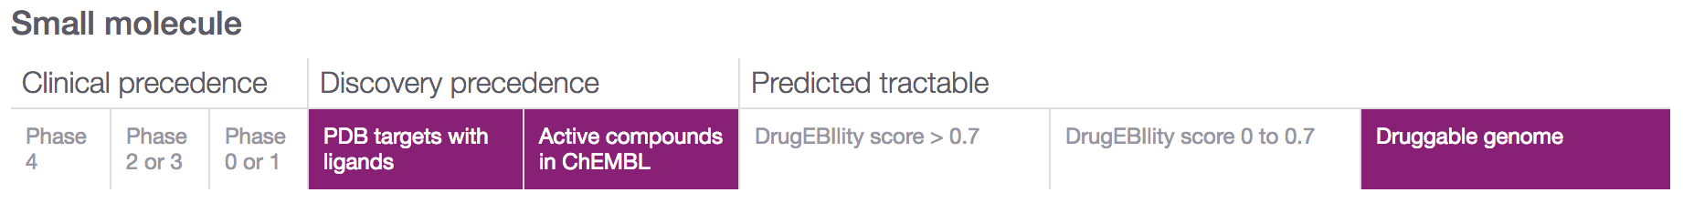
Is my target tractable?
DOI:10.1517/17460441.3.4.391
https://www.immunology.org/structure-antibody-1972

Slide 27
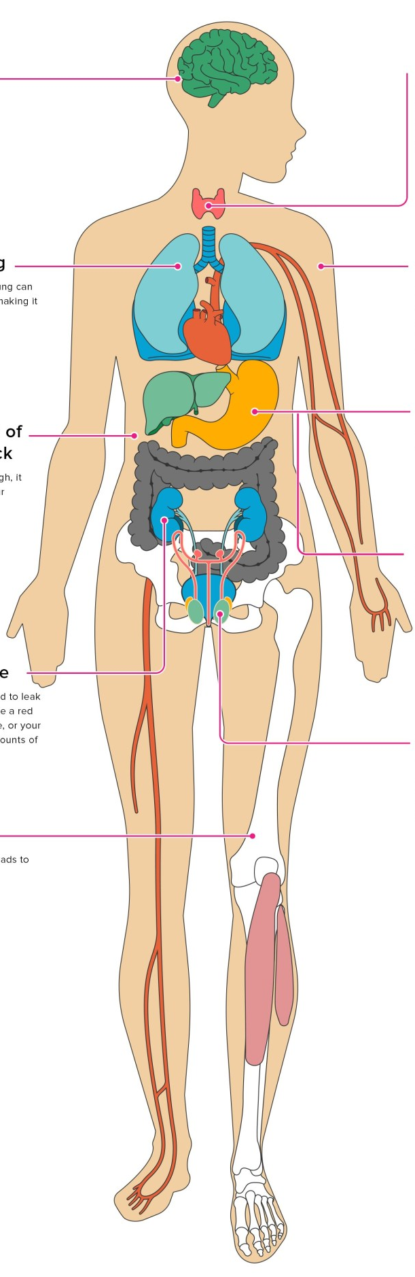
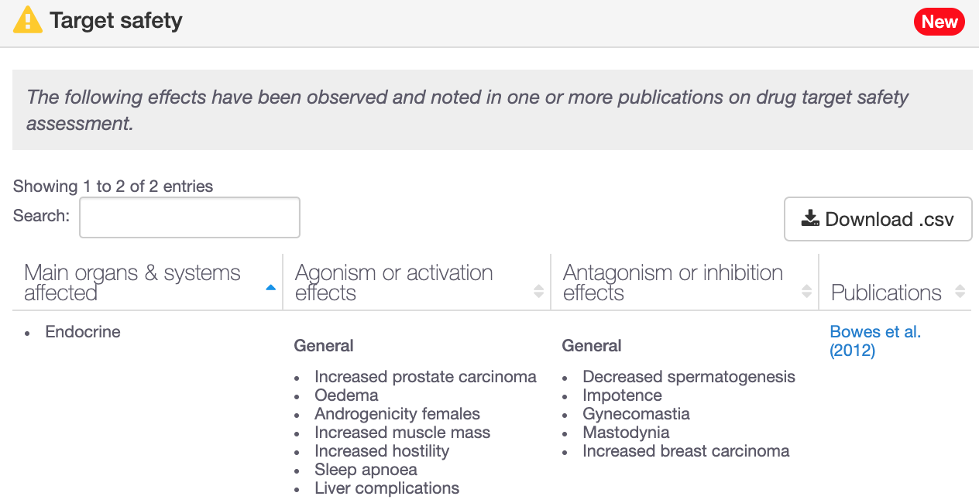
Is my target safe to be modulated?
193 genes with target safety information
Drowsiness
Increased heart rate
Hepatotoxicity

Slide 28
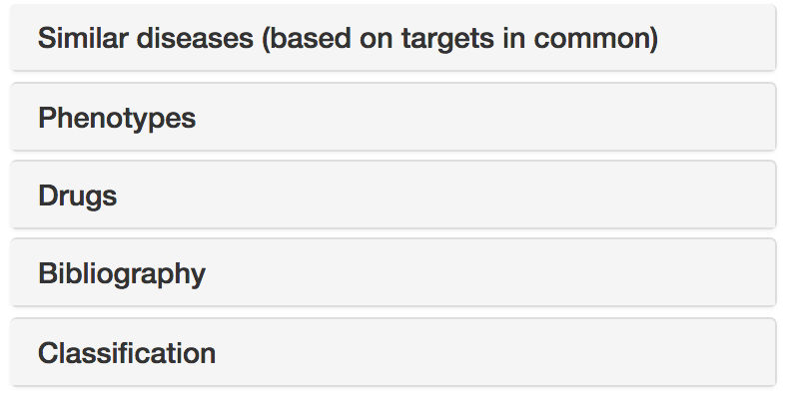




Disease annotations
Disease profile page
https://docs.targetvalidation.org/getting-started/getting-started/disease-profile

Slide 29
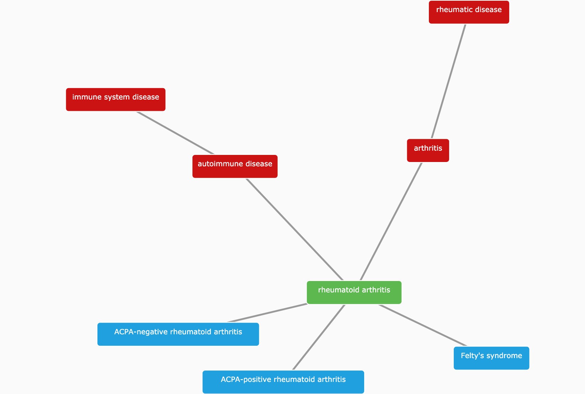
(Disease) Classification
https://www.targetvalidation.org/disease/EFO_0000685

Slide 30
Hands-on time
Demos
Exercises
Target (disease) annotations
Target centric workflow
Durvalumab
IBD
EGRF
Pages 16-25
Pages 26-29

Slide 31
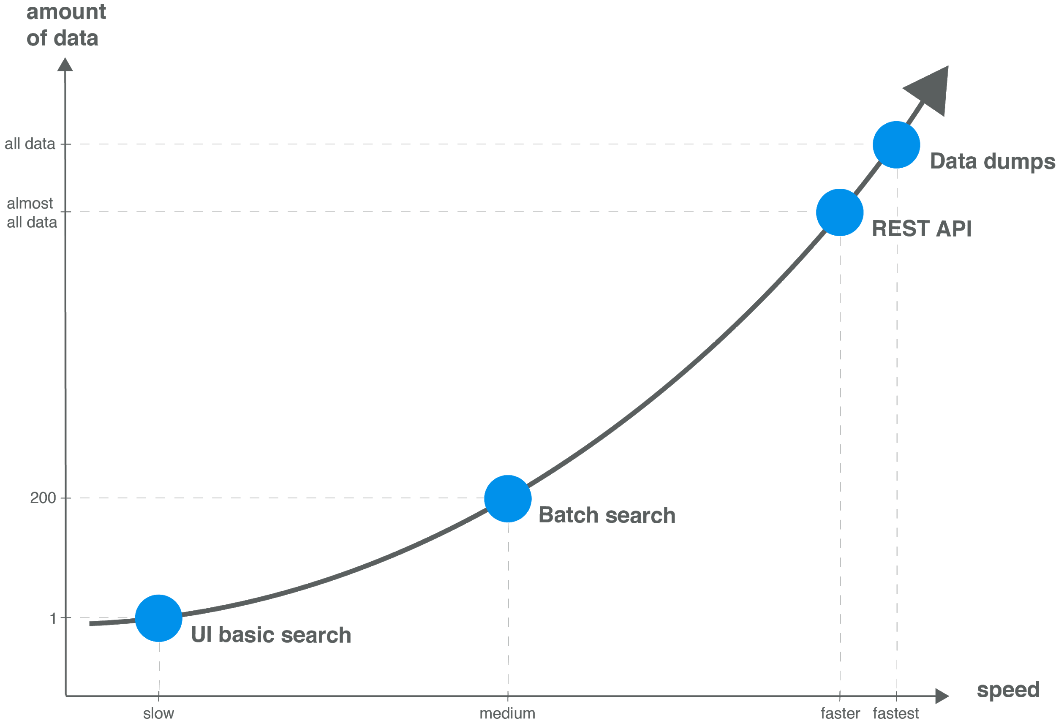
Modes of access → data volume

Slide 32
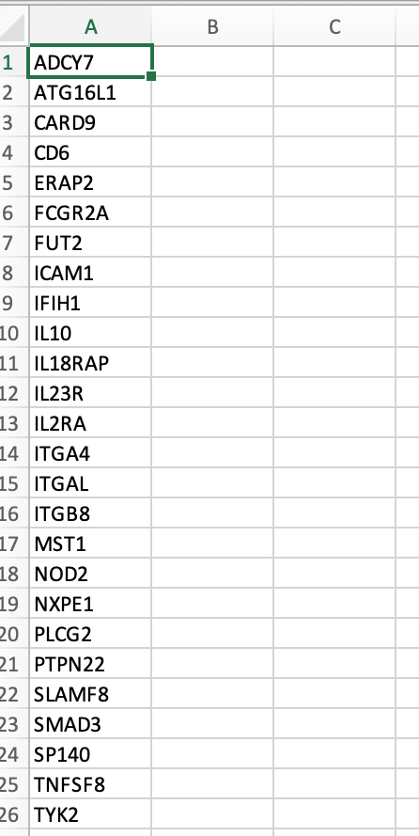
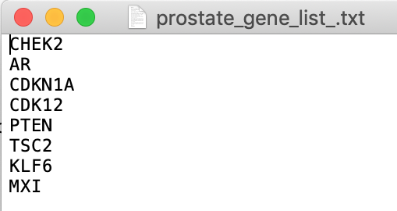
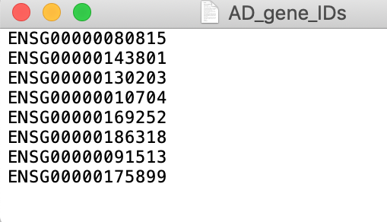
Have you got a list of targets?
Using the web interface, choose
Batch search or
”Your target list” filtering

Slide 33
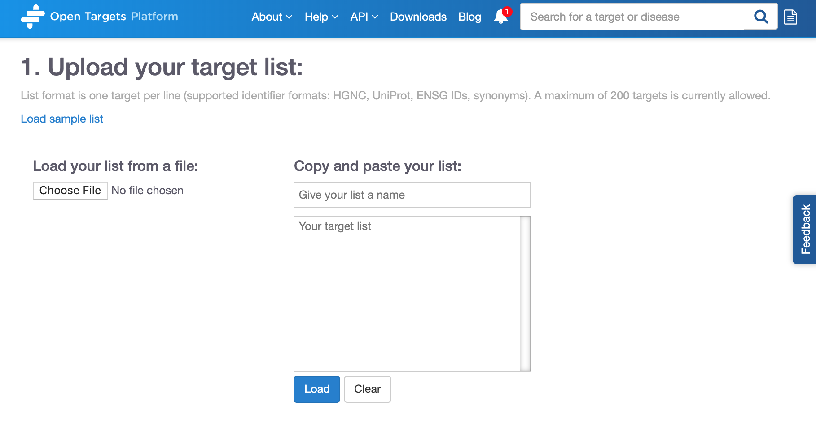
Batch search
https://www.targetvalidation.org/batch-search

Slide 34




Open Targets Platform REST API*
Server
https://platform-api.opentargets.io/v3/platform/
Endpoint
public/association/filter
Parameters
?target=ENSG00000163914&size=10000&fields=target.id&fields=disease.id
Open Targets Python client **
*
https://docs.targetvalidation.org/tutorials/rest-api
**
https://docs.targetvalidation.org/tutorials/python-client

Slide 35
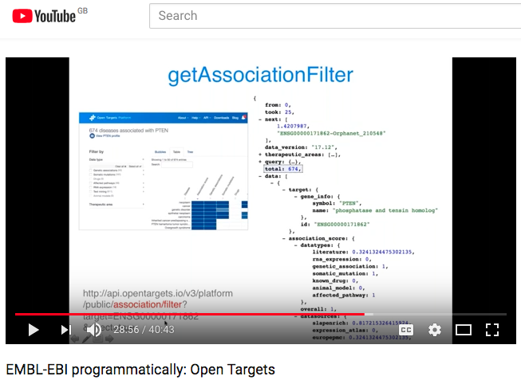
REST API
https://youtu.be/KQbfhwpeEvc

Slide 36
Extra hands-on exercises
E1-E3
Pages 30-32

Slide 37
Wrapping up
Resource of integrated multiomics data
Target identification and prioritisation
Graphical web interface: easy to use
REST-API for larger, more flexible queries
27K
targets
10K
diseases
3.3 M
associations
7.2 M
evidence
June 2019 release, 19.06

Slide 38
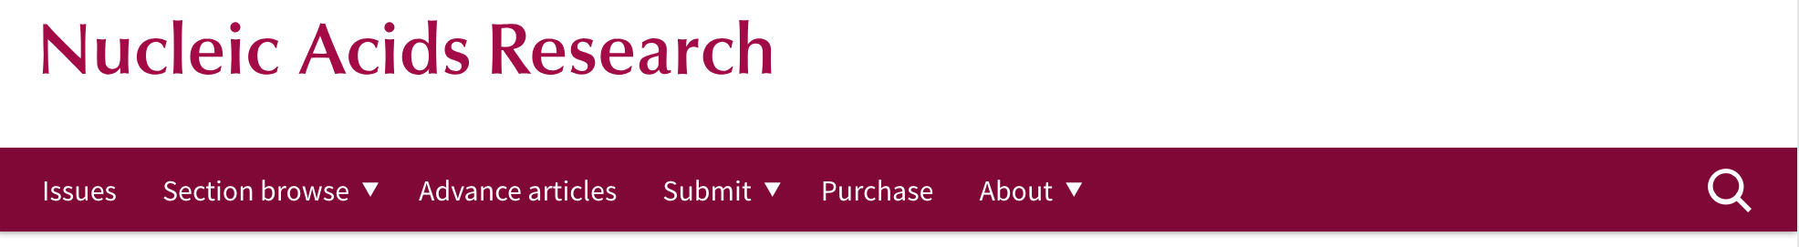
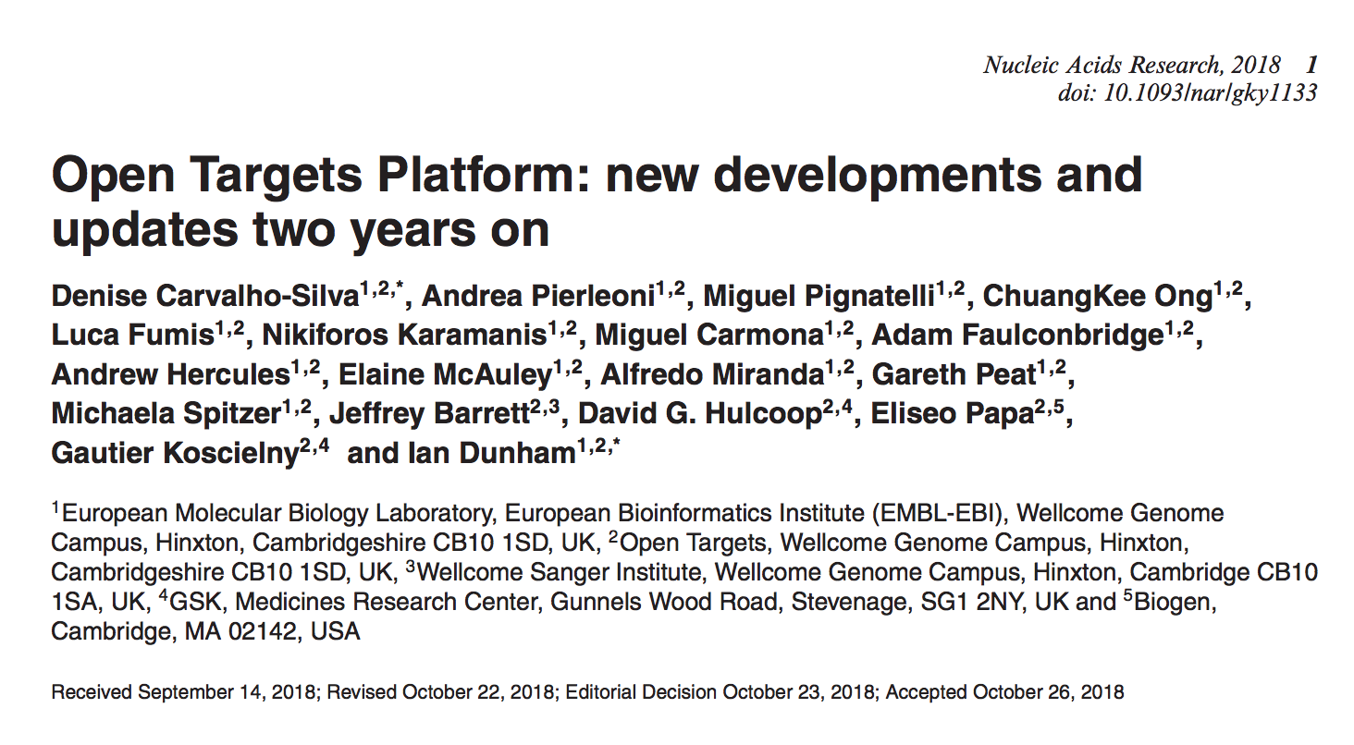
Want to learn more?
http://bit.ly/cite-us

Slide 39






Need help?
https://docs.targetvalidation.org/
support@targetvalidation.org
https://tinyurl.com/opentargets-youtube
@targetvalidate
http://tinyurl.com/opentargets-in
blog.opentargets.org/

